Slide 1
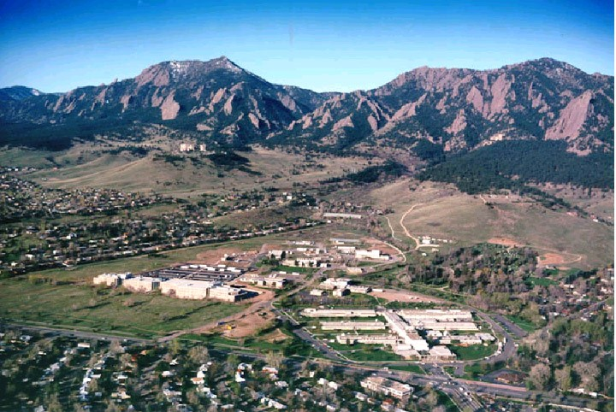

Report on NIST activities
2017
Michael Lombardi

Slide 2
OUTLINE
Contribution to Coordinated Universal Time (UTC)
Primary and Secondary Frequency Standards
Time Dissemination and Services
Advancing GPS and its applications

Slide 3
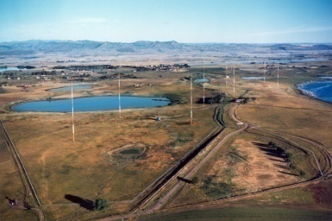
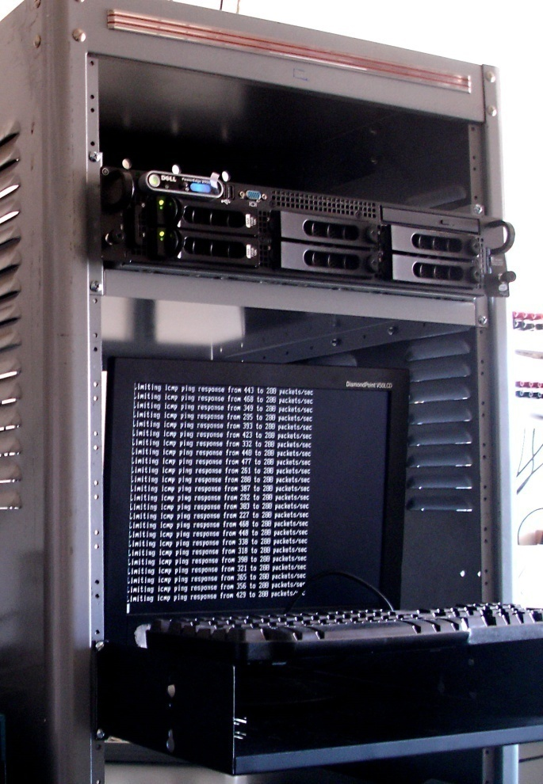
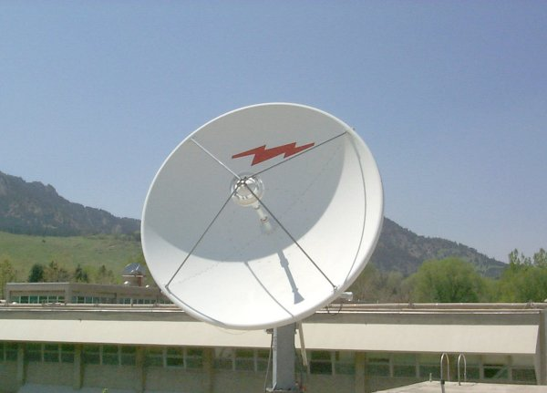
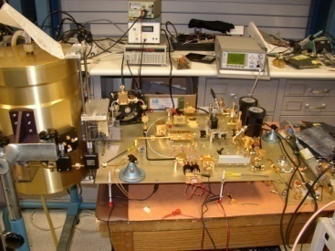
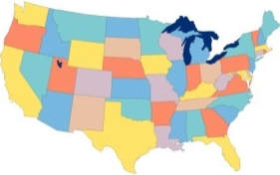
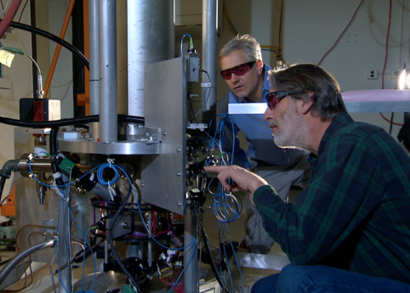
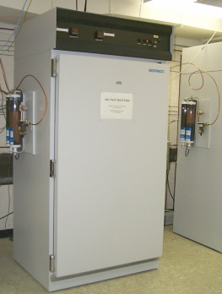
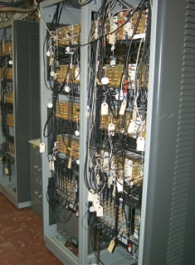
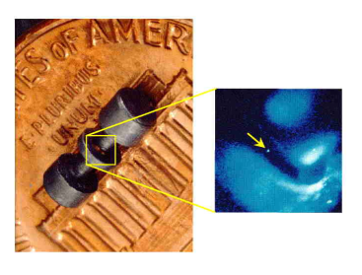
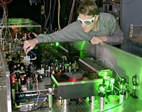
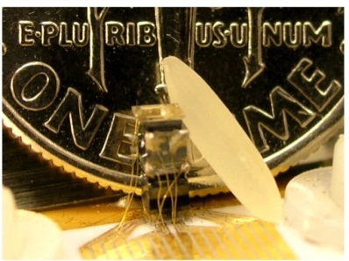
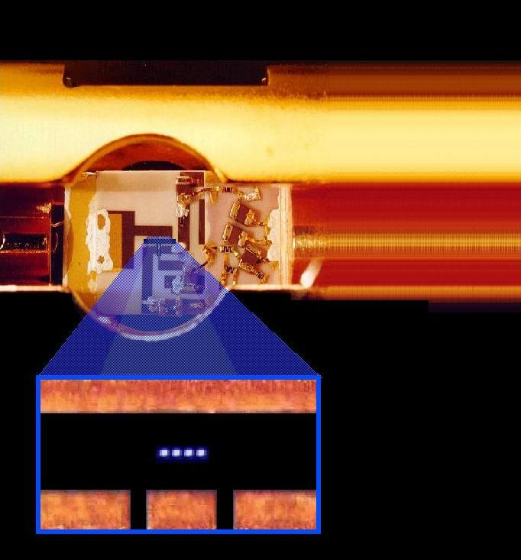
NIST Time and Frequency Standards and Distribution
Time and Frequency Distribution Services
Radio broadcasts
Networks
Satellites
Noise metrology
Primary Frequency Standards and
NIST Time Scale
Realization of SI second
Hydrogen Maser &
Measurement system
NIST-F2
Research on Future Standards and Distribution
Optical clocks
Optical frequency
synthesis
Chip-scale atomic devices
Quantum computing

Slide 4
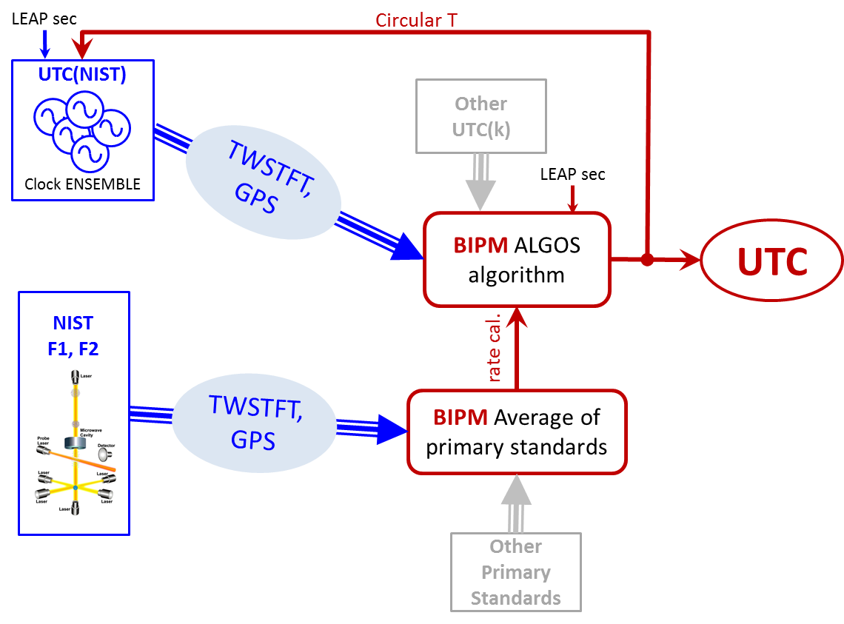
UTC
Coordinated Universal Time (UTC) is the official world time scale.
UTC(NIST) is the local realization of UTC. The UTC(NIST) time scale consists of an ensemble of hydrogen masers and cesium clocks.
NIST maintains and operates UTC(NIST) and the U. S. Primary Frequency Standards, cesium fountain devices F1 and F2.
The time transfer links between NIST and BIPM are based on
  Two-Way Satellite Time and Frequency Transfer (TWSTFT) measurements utilizing geostationary satellites.
  GPS common-view measurements.
UTC is computed by the International Bureau of Weights and Measures (BIPM) in France.

Slide 5
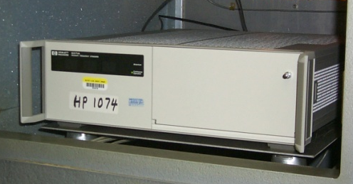


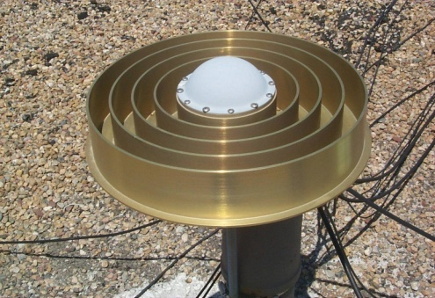
UTC
4 Cesium Beam standards
Two-way satellite time & frequency transfer
UTC(NIST)
6 Hydrogen Masers
GPS
Measurement System

Slide 6
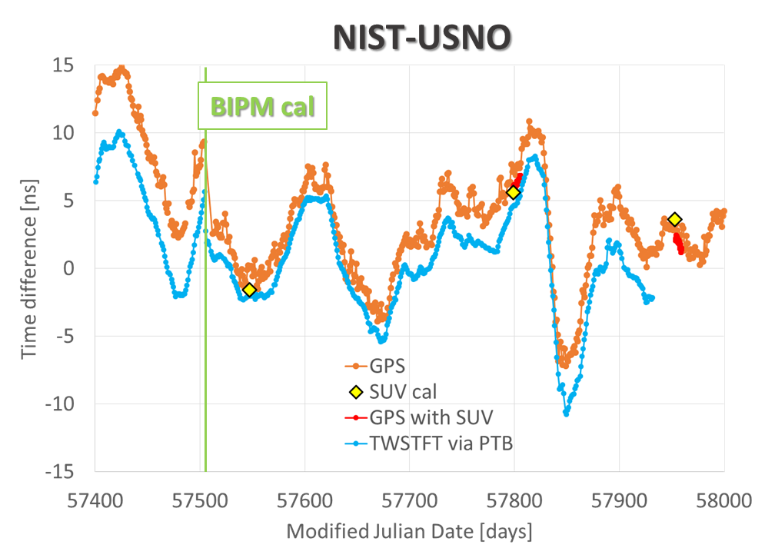
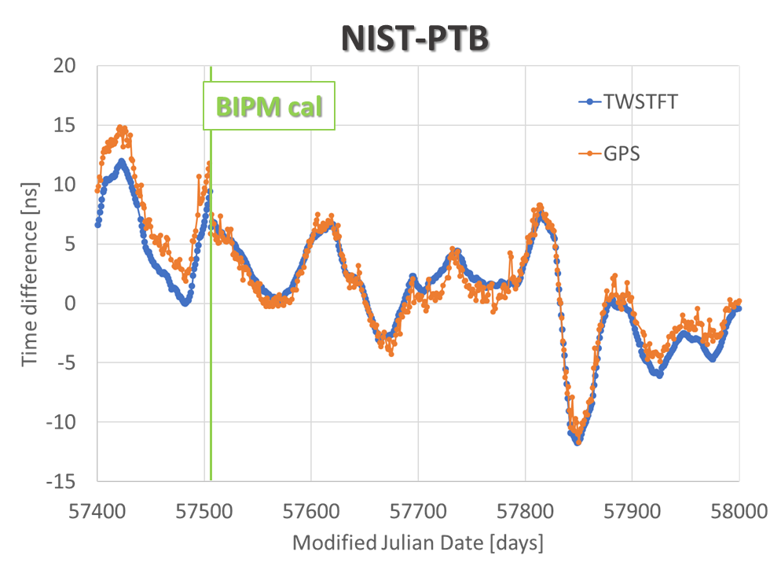
UTC
CALIBRATIONS OF TIME TRANSFER LINKS
USNO shares with NIST the responsibility of maintaining accurate realizations of UTC in the US
PTB is the pivot point for UTC
GPS with SUV cal: common-view calibration
SUV: TWSTFT mobile station owned by USNO, periodically driven to NIST in Boulder, CO
GPS: common-view
TWSTFT: Direct or indirect intercontinental satellite link

Slide 7
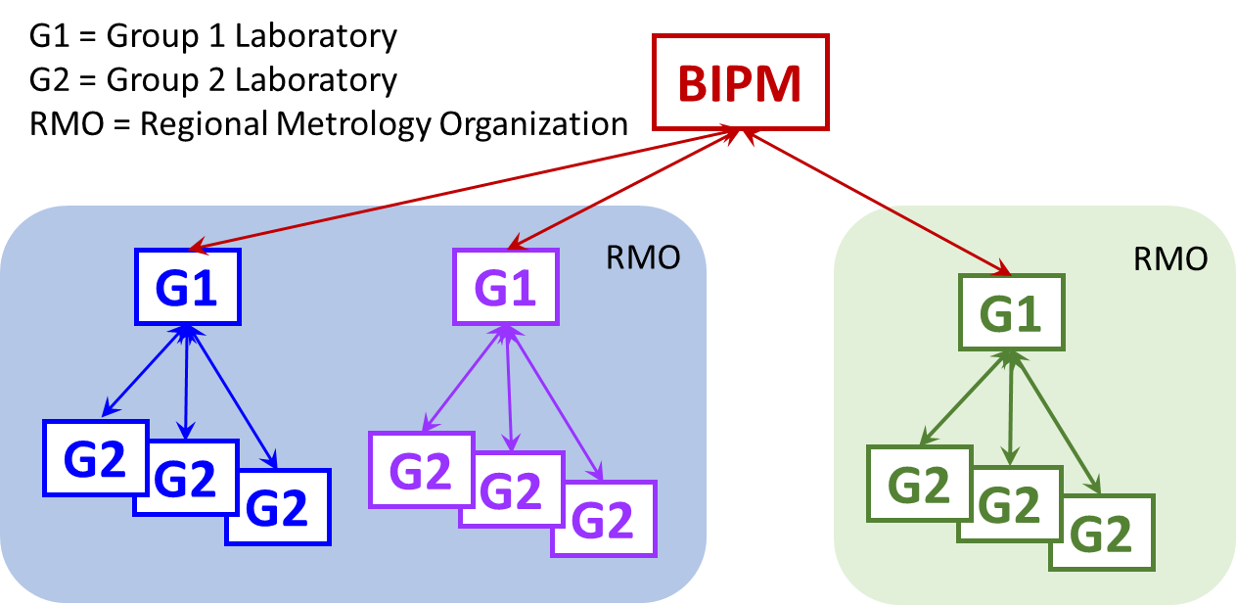
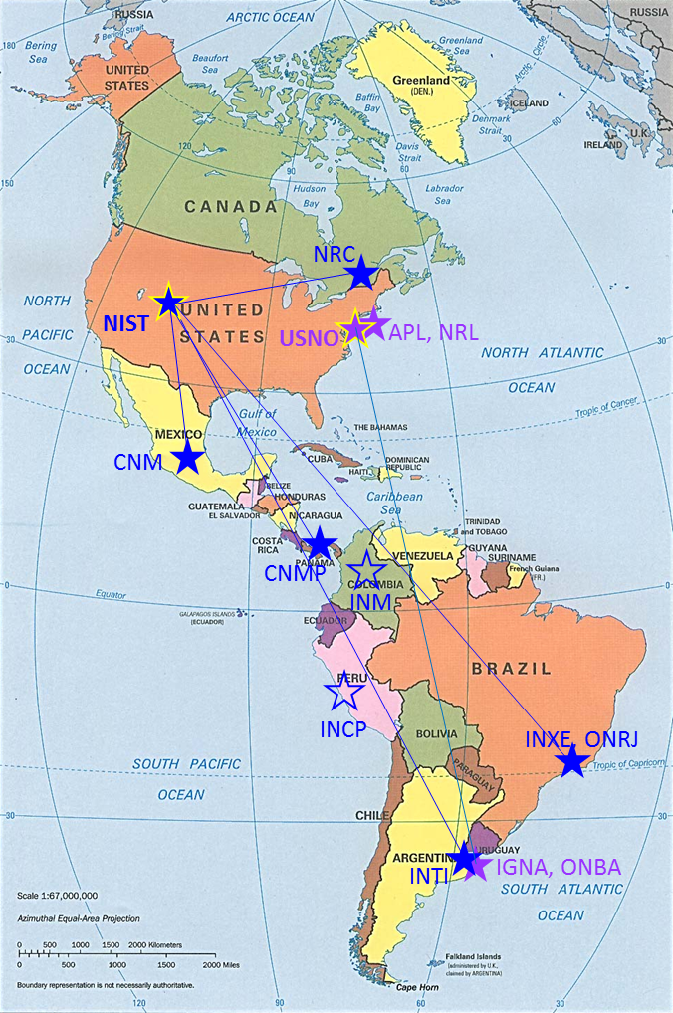

UTC
BIPM issued updated Calibration Guidelines for all laboratories contributing to UTC
NIST (Boulder, CO, USA)
CNM (Queretaro, MEXICO)
CNMP (PANAMA)
INTI (Buenos Aires, ARGENTINA)
INXE (Rio de Janeiro, BRAZIL)
NRC (Ottawa, CANADA)
ONRJ (Rio de Janeiro, BRAZIL)
INM (Bogota, COLOMBIA)
INCP (Lima, PERU)
USNO (Washington, DC, USA)
APL (Laurel, MD, USA)
IGNA (Buenos Aires, ARGENTINA)
NRL (Washington, DC, USA)
ONBA (Buenos Aires, ARGENTINA)

Slide 8
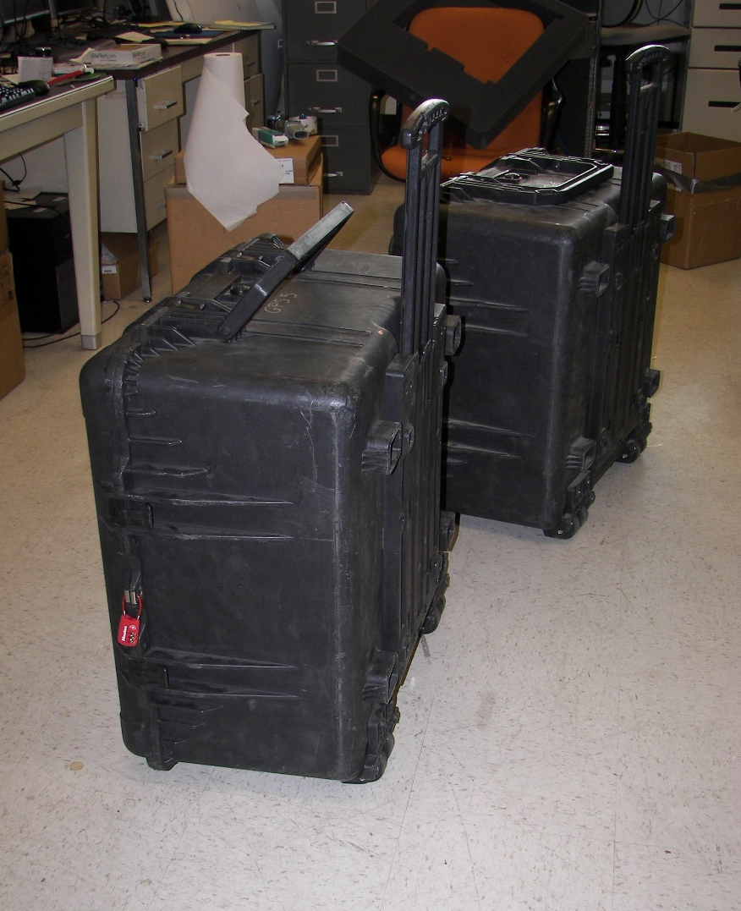
UTC
G2 CALIBRATION CAMPAIGNS
✓
Trip 1:
NRC (Ottawa, CANADA)
Trip 2:
CNM (Queretaro, MEXICO)
CNMP (PANAMA)
Trip 3:
NRC (Ottawa, CANADA)
Trips 4-5:
INTI (Buenos Aires, ARGENTINA)
INXE (Rio de Janeiro, BRAZIL)
ONRJ (Rio de Janeiro, BRAZIL)
COMPLETED!
✓
COMPLETED!
✓
COMPLETED!
EARLY 2018
NIST Travelling System

Slide 9
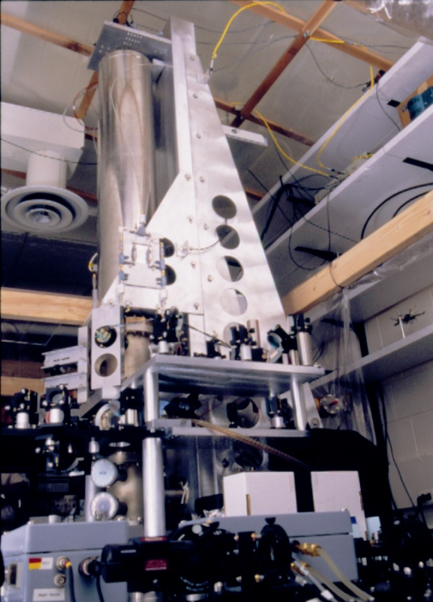
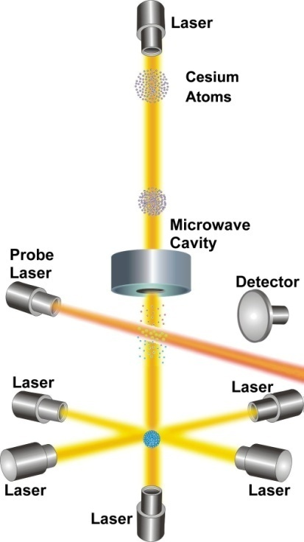
Frequency Standards
PRIMARY FREQUENCY STANDARD FOR THE UNITED STATES
NIST-F1 Atomic Fountain Clock
1 second is defined as the duration of 9,192,631,770 periods of the radiation corresponding to the transition between the two hyperfine levels of the ground state of the ¹³³Cs atom.
Current accuracy (uncertainty):
3 x 10⁻¹⁶ second.
25 trillionths of a second per day.
1 second in 100 million years.
Re-evaluation of all systematic effects after move to new labs

Slide 10
Frequency Standards
SECONDARY: OPTICAL
Al⁺ 1124 THz
Hg⁺ 1064 THz
Yb 520 THz
Ca 456 THz
Sr 429 THz
Cs 0.0092 THz
Ion Clocks
Neutral Clocks
F1, F2

Slide 11
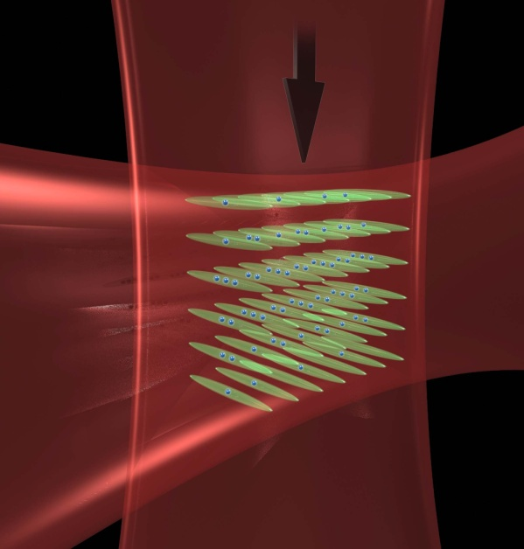
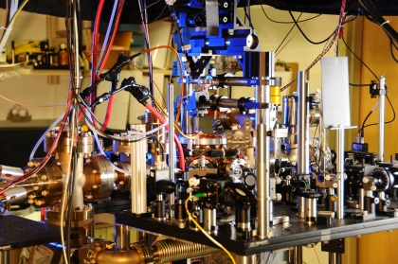

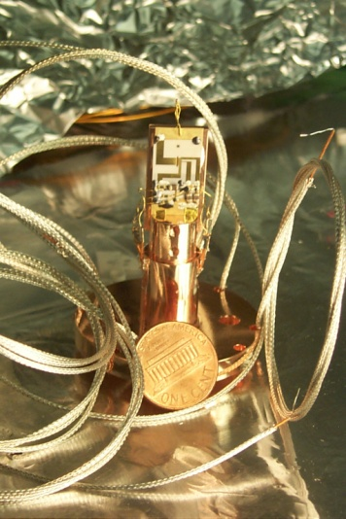
Frequency Standards
SECONDARY STANDARDS: OPTICAL CLOCKS
Δf/f ~ 6 x 10⁻¹⁸
Al⁺ 1124 THz
Hg⁺ 1064 THz
Yb 520 THz
Ca 456 THz
Sr 429 THz
Ions
Neutrals
Sr or YB optical lattice clocks
Δf/f ~ 8 x 10⁻¹⁸
Δf/f ~ 10 x 10⁻¹⁸
Single Hg ion trap
Al ion logic clock

Slide 12
DISSEMINATION
TMAS FMAS NISTDO
NIST provides common-view GPS measurement systems to its remote customers, allowing them to compare their clocks to UTC(NIST) by using the GPS.
The common-view data is processed in real-time and shows the time or frequency difference between UTC(NIST) and the customer’s clock.
FMAS: reports frequency uncertainty to the customer
TMAS: reports time uncertainty to the customer
NISTDO: locks the customer’s clock (rubidium or cesium) to the UTC(NIST)
Customers can then show traceability to the International System (SI) of units through NIST.

Slide 13
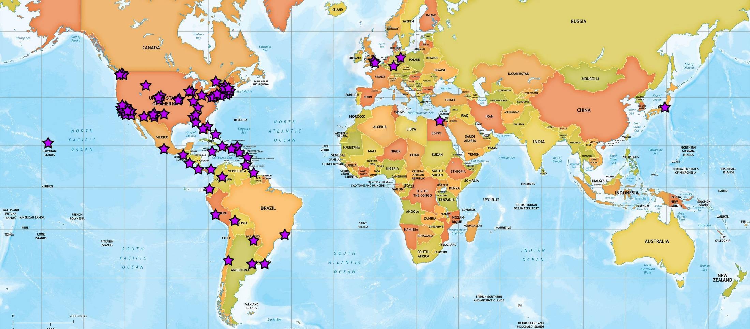
DISSEMINATION
Map of Common-View GPS Systems
(78 total systems deployed, 53 at customer sites and 25 in SIM Time Network)

Slide 14
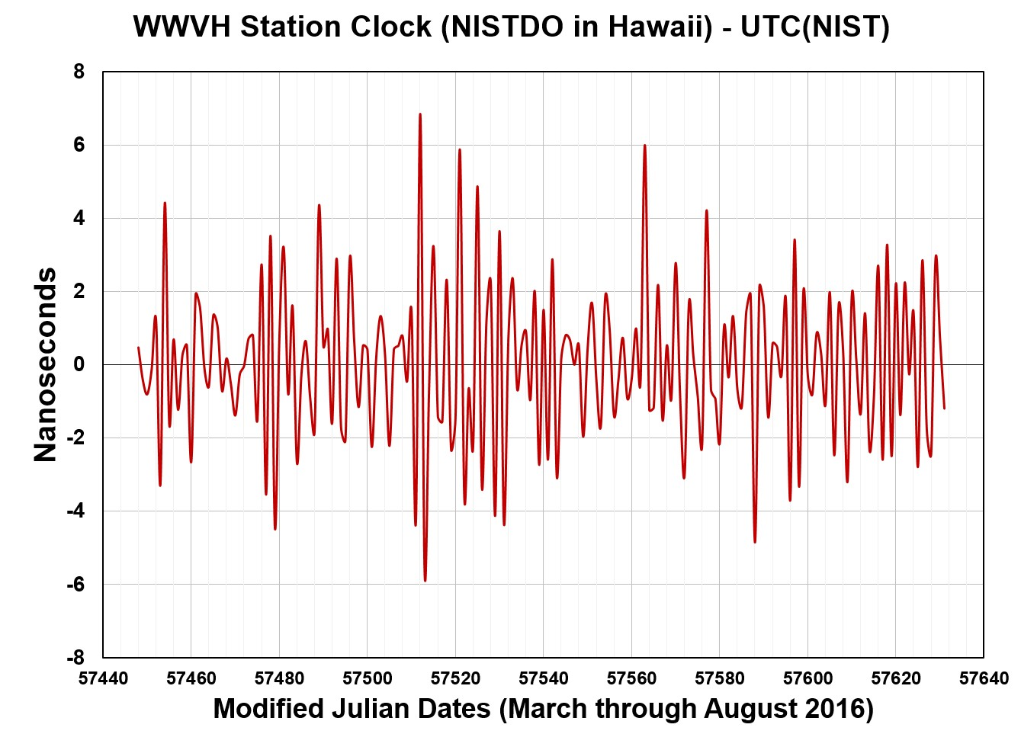
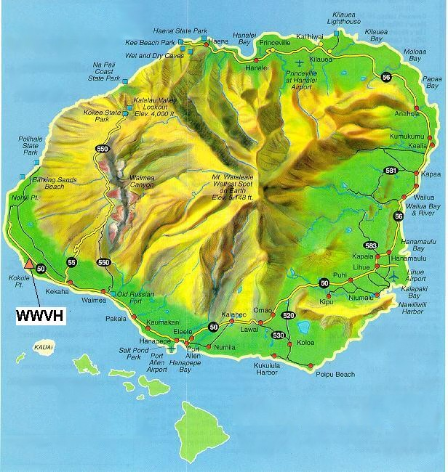
DISSEMINATION
A NISTDO is the station clock at WWVH in Kauai
The Boulder-Kauai baseline is long (5324 km) and Internet access at WWVH is through a satellite and is not always available.
Even so, the average time offset is near 0 and peak-to-peak time variations are usually within ±10 ns of UTC(NIST) in Boulder.

Slide 15
DISSEMINATION

Slide 16

Time By Radio: WWVB
WWVB low frequency broadcast of time code signals (60 kHz). Began broadcasting from Fort Collins, Colorado in 1963.

Slide 17
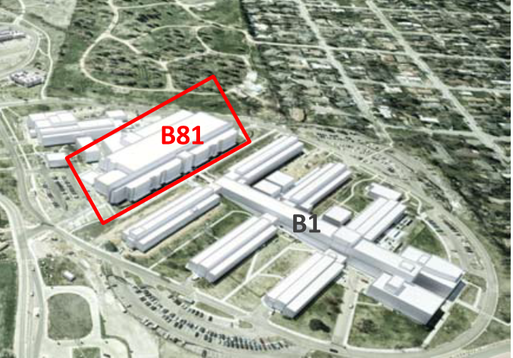
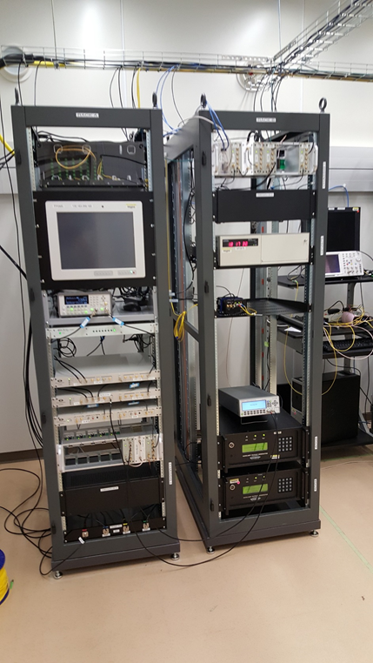
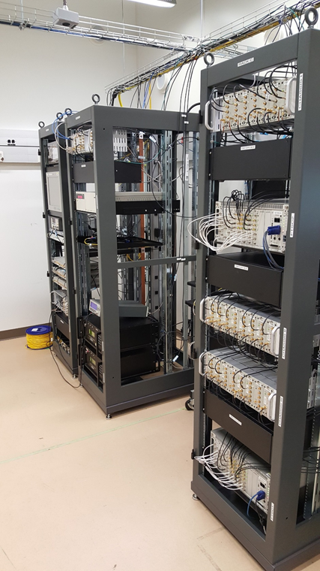
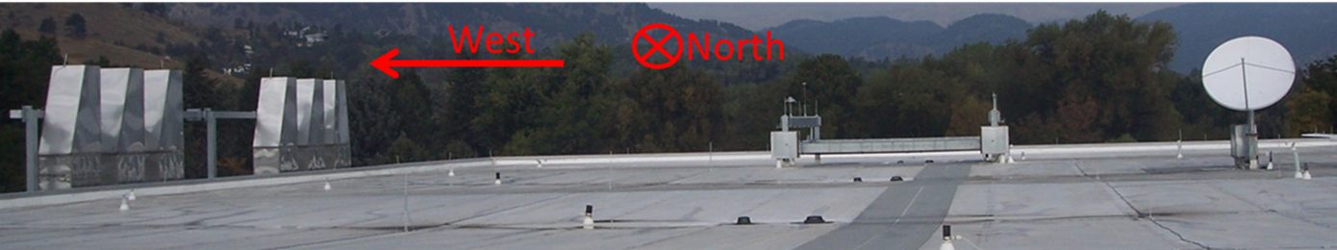
NEW LABORATORIES
Time scale migration in process
Second TW station for link with USNO
Room-temperature fountain standard (F1)
Optical frequency standards and frequency comb
Optical fiber link between buildings (time scale)
Secondary time reference points (clock trips)

Slide 18
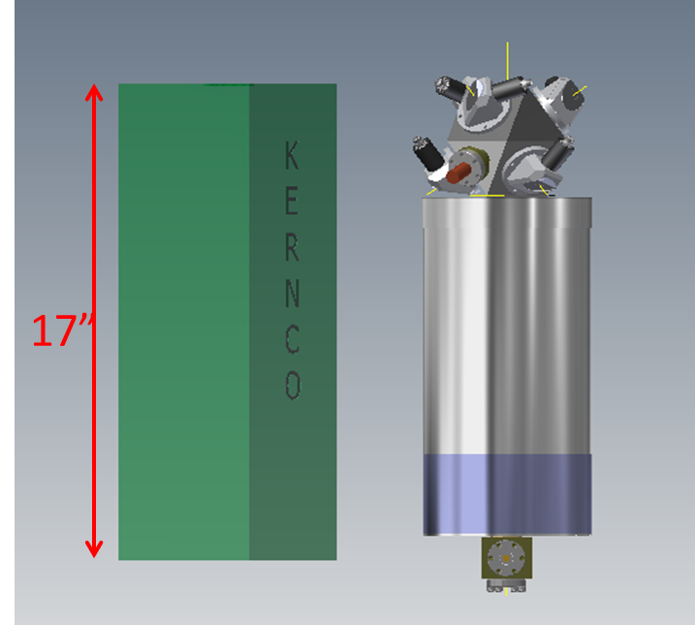
EXPLORING NEW IDEAS
Laser-cooled Atomic clocks for GPS satellites
NIST is involved in the Air Force Research Lab program to support the Navigation Technology Satellite 3 (NTS-3), as well as possible future clocks for GPS.
The current clock technology is unlikely to be significantly improved
KernCo
13kg
< 30W
Terrestrial measured
in space
NTS-3
on-orbit goal
Volume ~ 1.3 * legacy KernCo

Slide 19
Work in Progress
BIPM-sponsored pilot program with Beidou GNSS receiver for time transfer
Regular measurements of maser frequency using Yb optical clocks
Regular intercomparisons between optical clocks (Yb, Al and Sr)
First report of optical secondary frequency standards to BIPM
Atomic Clock Ensemble in Space (ACES): installation of Microwave Ground Terminal next spring

Slide 20
THANK YOU!

